Slide 1



March 5, 2025
Presented by: Team 011
Ayush Trivedi
Dheeraj Pamnani Dominic Darrah Riya Agarwal
Sravani Bolla
YELP DATA ANALYSIS
CIS 509 : Analytical Unstructured data

Slide 2


TABLE OF CONTENTS
A
D
Business Problem Definition
Methodology
B
E
Dataset scope/ Filtering conditions
Insights/Results
C
Exploratory Data Analysis
F
Conclusion

Slide 3


BUSINESS PROBLEM
For restaurants, customer satisfaction and loyalty are shaped by various factors, including food quality, service, pricing, and ambiance.
By exploring the relationship between reviews, customer recommendations (tips), and star ratings, we aim to identify key themes that drive positive dining experiences or lead to dissatisfaction.
By understanding what aspects of a restaurant customers frequently recommend, businesses can leverage these insights to enhance their offerings, improve reputation, and attract more guests.

Slide 4



DATASET SCOPE
Data Source
Review Dataset
Business Dataset
Tip Dataset
Filtering Criteria
State filtering (States: PA and FL)
Category filtering (Categories of restaurant that serve American, Chinese, and Italian cuisine)
Source: https://business.yelp.com/data/resources/open-dataset/

Slide 5


SUMMARY STATISTICS
Number of Tokens | 98,334,233
Number of Unique words | 297,193
Number of Unique customers | 351,921
Number of Businesses | 8,642
Number of Reviews for PA | 566,833
Number of Reviews for FL | 398,808
Number of Reviews for American Cuisine Restaurants | 676,072
Number of Reviews for Chinese Cuisine Restaurants | 100,164
Number of Reviews for Italian Cuisine Restaurants | 189,405
Total Review Count: 965,641

Slide 6

ANALYSIS PROCESS
Sentiment Analysis - Word Cloud EDA among the star ratings and tips data
Topic Modeling for Review and Tips dataset
Sentiment Classification and Topic Modeling
Regional and Cuisine Comparison using Topic Modeling

Slide 7
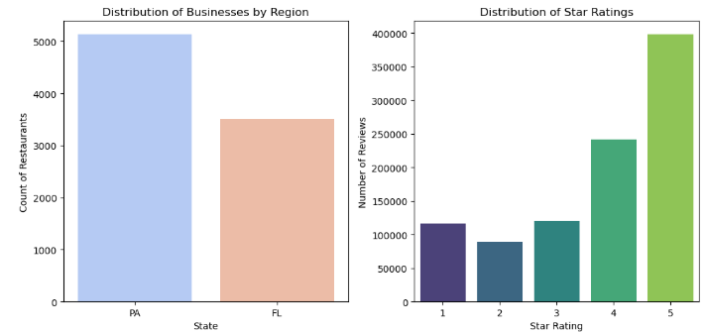
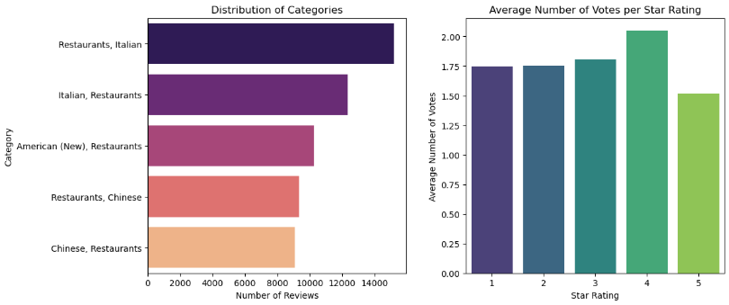
EXPLORATORY DATA ANALYSIS

Slide 8
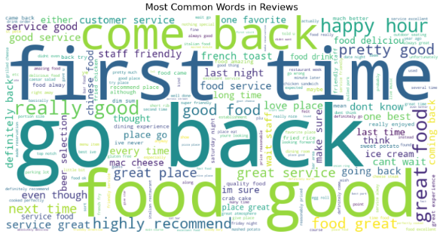
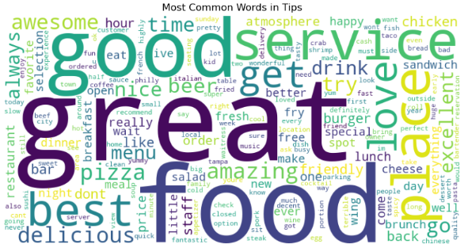
EDA Continued…
Most Common Bigrams: [('go back', 50134), ('first time', 44208), ('food good', 41493), ('come back', 38685), ('really good', 36543), ('great food', 35663), ('happy hour', 34840), ('highly recommend', 31812), ('food great', 30288), ('good food', 29699)]
Most Common Trigrams: [('wait go back', 8055), ('cant wait go', 7612), ('cant go wrong', 6117), ('food great service', 6071), ('definitely go back', 5993), ('definitely come back', 5903), ('sweet potato fry', 5683), ('would go back', 5609), ('great food great', 5429), ('mac n cheese', 4906)]
Most Common Bigrams in Tips: [('in the', 26547), ('of the', 20792), ('and the', 19807), ('on the', 18690), ('the best', 17724), ('for a', 17660), ('food and', 17203), ('for the', 15973), ('is a', 14960), ('is the', 14002)]
Most Common Trigrams in Tips: [('This place is', 6884), ('Great food and', 4681), ('of the best', 3886), ('is the best', 3421), ('The food is', 3085), ('Great place to', 2897), ('the food is', 2812), ('I love this', 2768), ('one of the', 2467), ('One of the', 2451)]

Slide 9
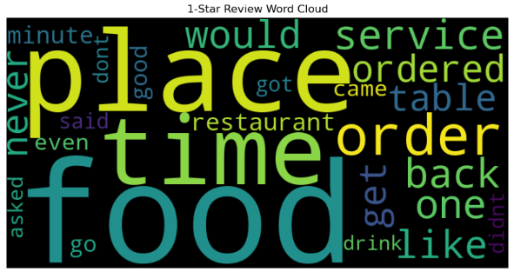
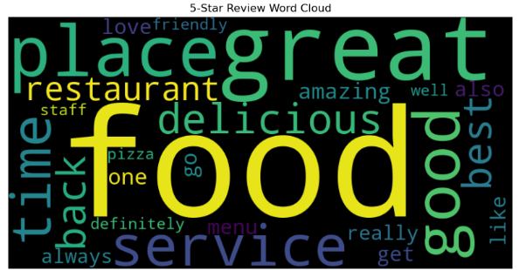
EDA Continued…
1-Star Reviews: reveal complaints about food, service, delays, and overall experience.
5-Star Reviews: highlight praise for "food," "great," "delicious," "service," and "good," reflecting excellent dining experiences.

Slide 10
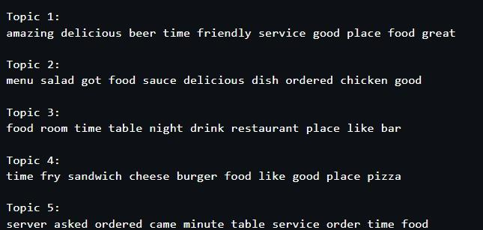
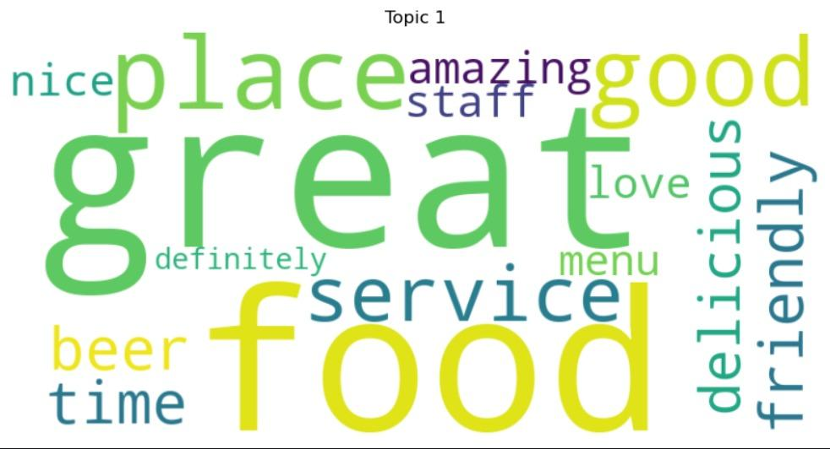
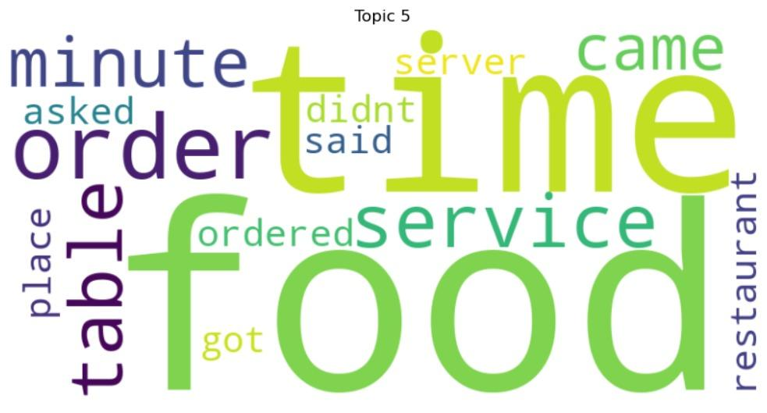
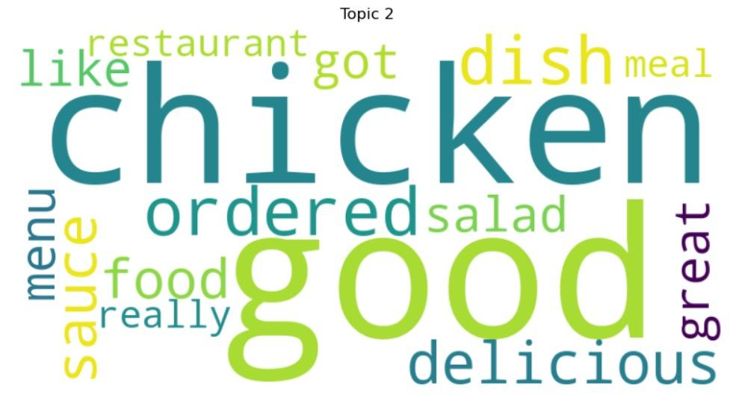
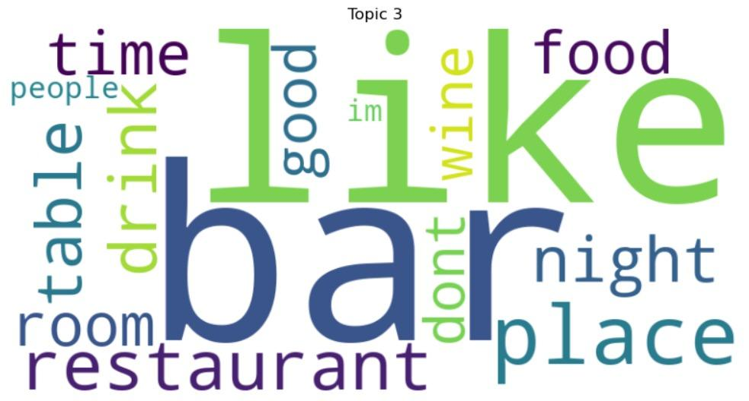
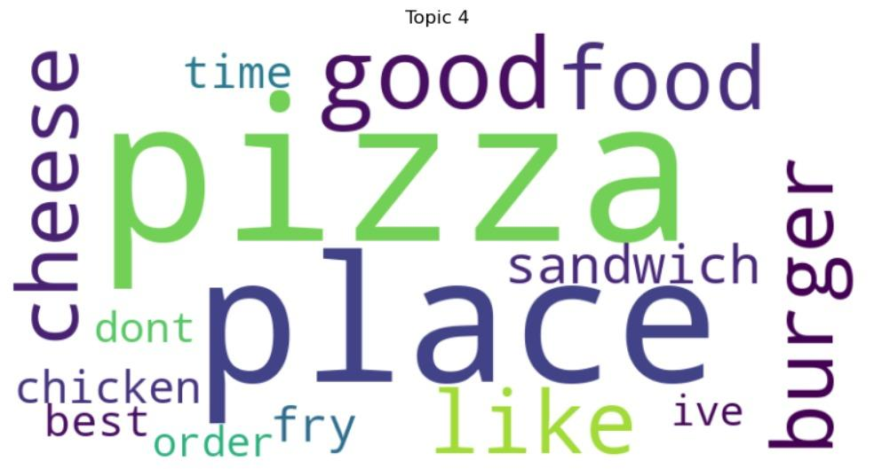
Topic Modeling - Review

Slide 11
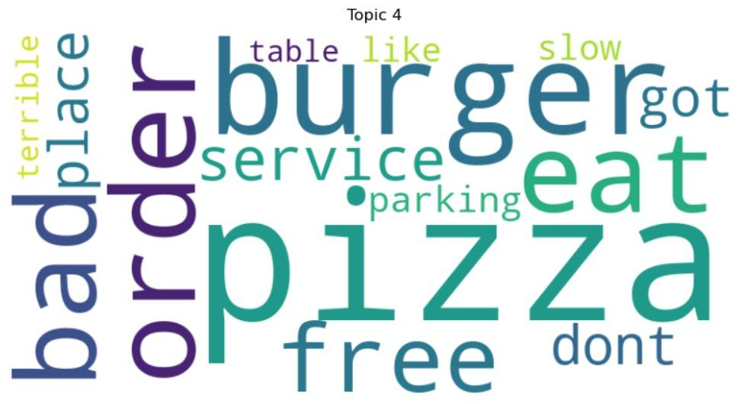
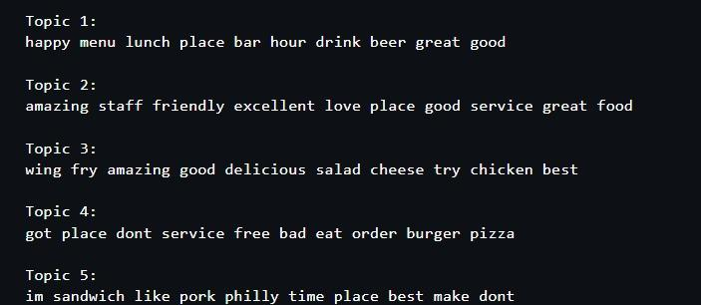
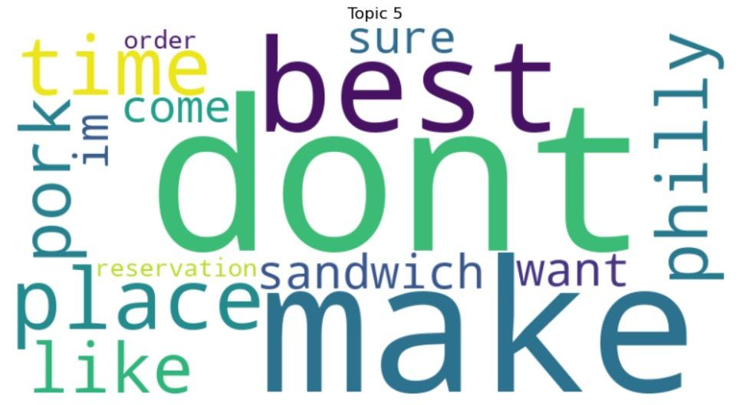
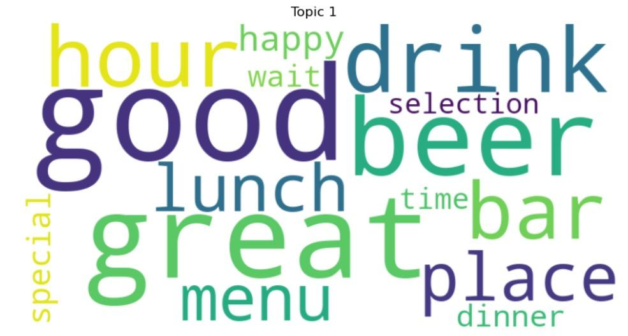
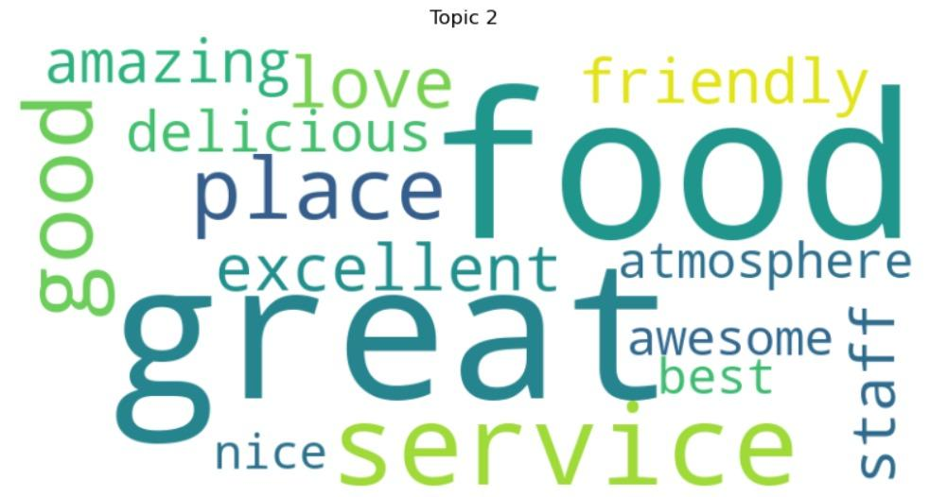
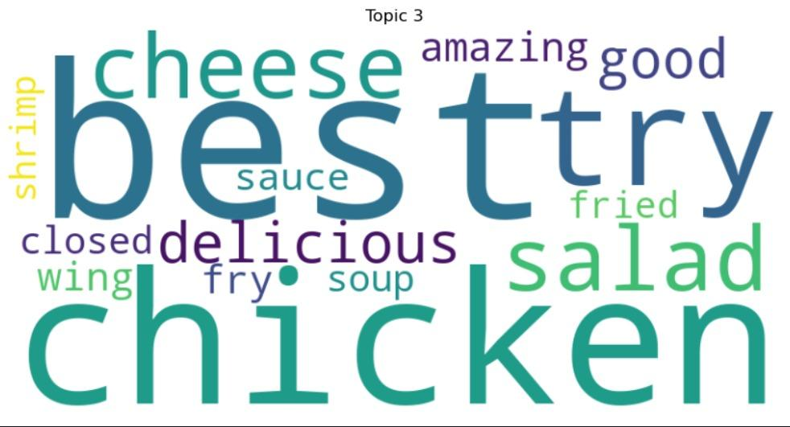
Topic Modeling - Tip

Slide 12
BERT Topic Modelling with UMAP
NLP METHODOLOGY
Data Preprocessing and Merging
Merged review ratings (sentiment based on stars) with tip and business files, cleaned the text in tip file(using NLTK stop words, standardization, removing alphanumeric characters), and filtered data by states, cuisines, and sentiment.
2. Class Balancing
Balanced all classes by -
Step1: grouping them and finding minimum group size.
Step2: Equally dividing the inter-class ratios for each class based on min-group size
3. Topic Modeling and Visualization
BERTopic for topic modeling on cleaned tip text in merged file with UMAP reducing dimensions of embedding, further reduced model to 30 topics, and assigned topic labels and probabilities.
Visualised topics generated from tip text per class (sentiment, cuisine, state)

Slide 13
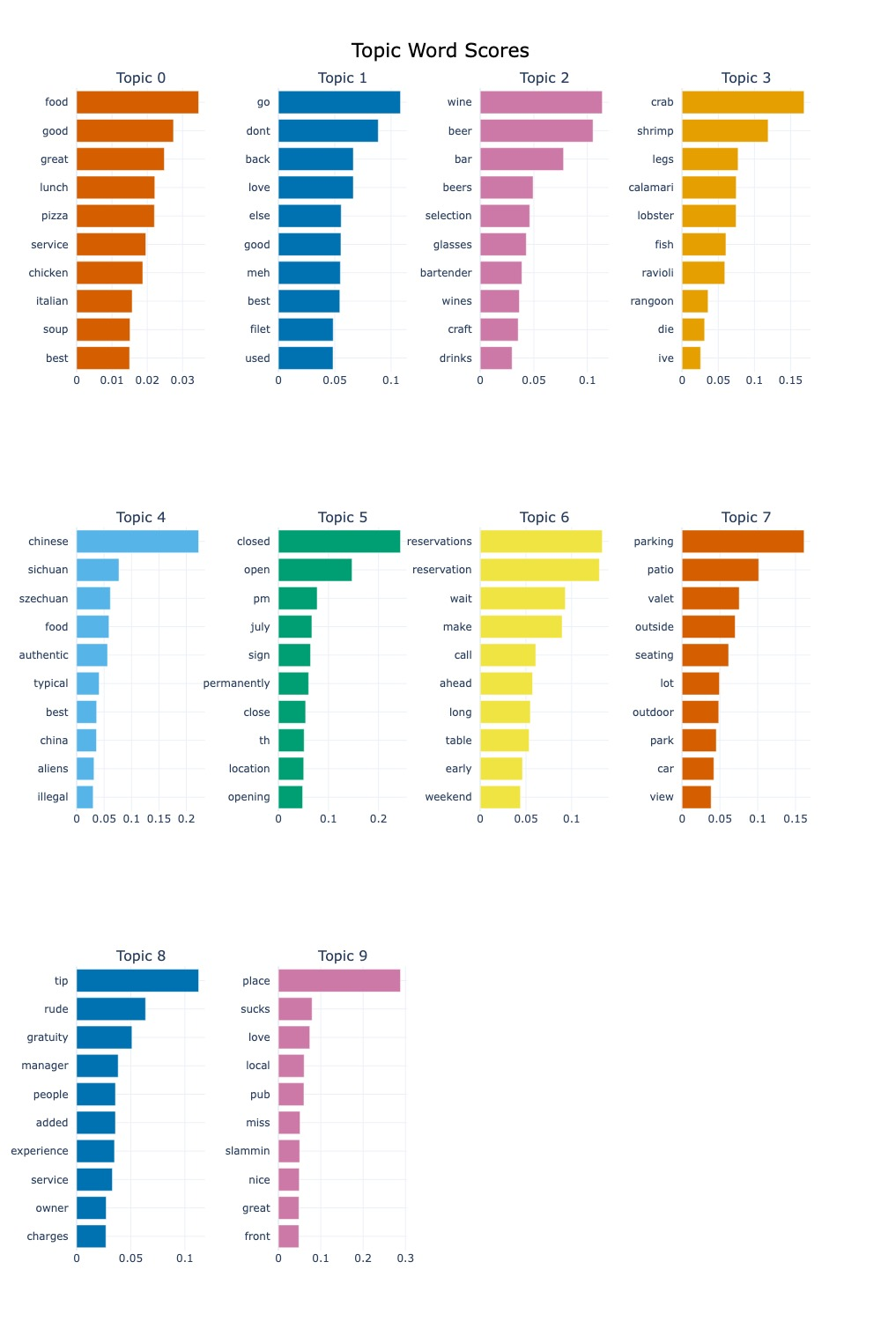
Topic Word Scores
Topic 0 - General Food Quality & Service
Insight: Positive food and service experiences drive high ratings.
Topic 1 - Mixed Customer Sentiments
Insight: Polarized opinions suggest inconsistent experiences.
Topic 2 - Drinks & Alcohol Selection
Insight: A strong beverage program enhances customer satisfaction.
Topic 3 - Seafood & Shellfish
Insight: Seafood quality is a critical factor in customer reviews.
Topic 4 - Chinese & Sichuan Cuisine
Insight: Authenticity is a major driver of satisfaction in ethnic cuisine.
Topic 5 - Restaurant Closures & Openings
Insight:Closures & inconsistent availability (-ve)ly impact perception.
Topic 6 - Reservations & Wait Times
Insight: Long wait times frustrate customers, efficient reservations matter.
Topic 7 - Parking & Outdoor Seating
Insight: Accessibility & seating options influence customer decisions.
Topic 8 - Tipping & Gratuity Issues
Insight: Unclear tipping policies and rude service harm ratings.
Topic 9 - General Negative Sentiment
Insight: Negative experiences lead to strong dissatisfaction in reviews.

Slide 14
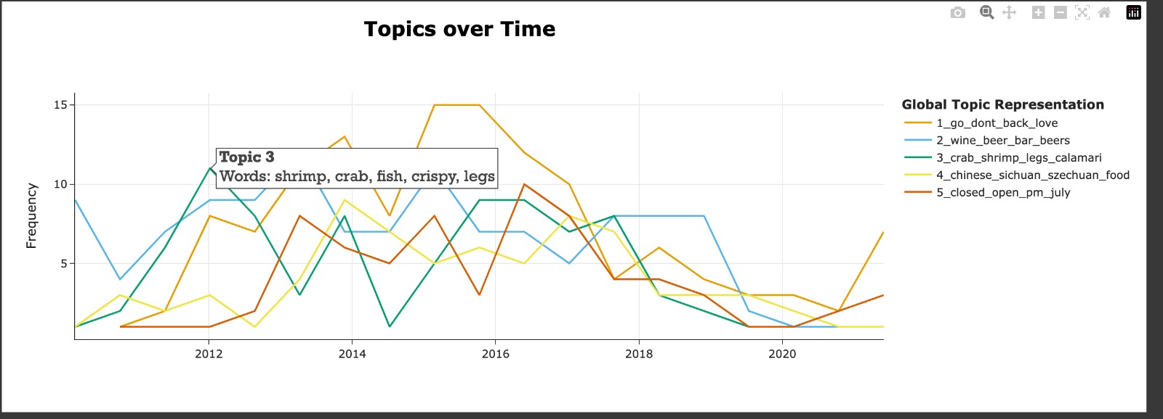
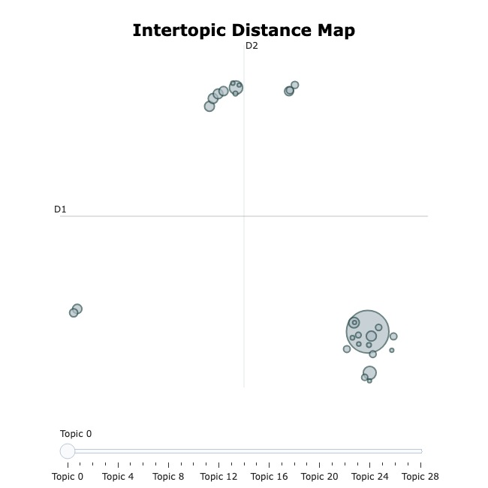
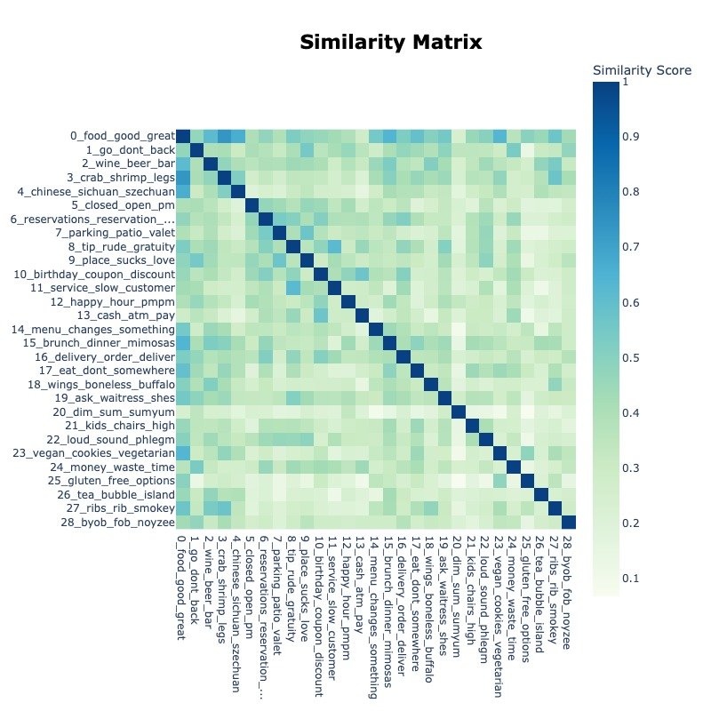
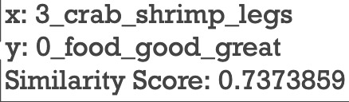
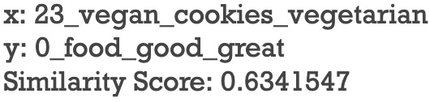
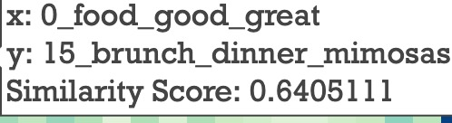
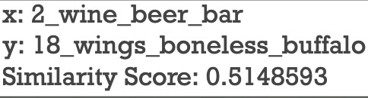
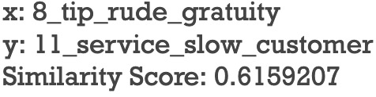
Insights/Results
Topics clusters, Correlation and Trend over time

Slide 15
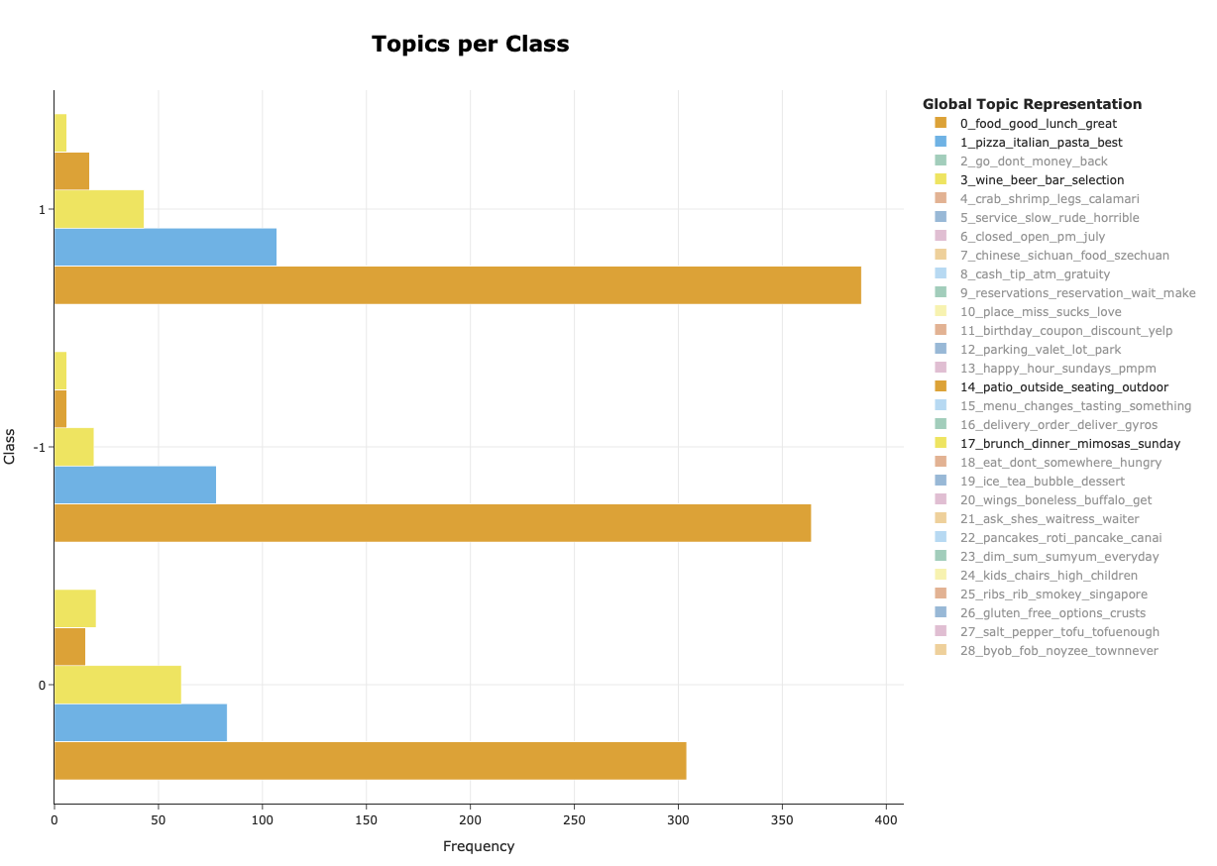
Insights/Results
Sentiment Classification Topic Modeling
All sentiments:
Topics:
food_good_lunch_great pizza_italian_past_best
Food quality is key indicator for overall restaurant experience
Positive sentiment:
Topics:
brunch_dinner_mimosas_sunday
wine_beer_bar_selection
patio_outside_seating_outdoor
Dining experience correlate with customer satisfaction
Ambiance and specific dishes

Slide 16
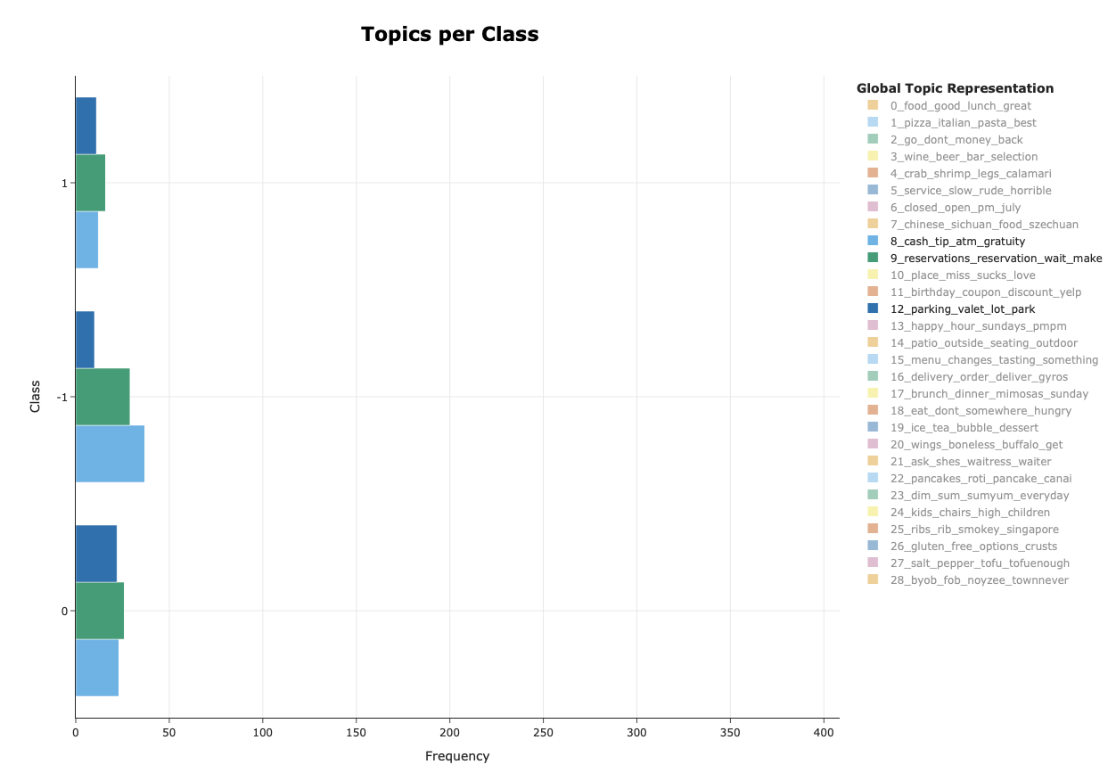
Insights/Results
Sentiment Classification Topic Modeling
Neutral sentiment:
Topics:
cash_tip_atm_gratuity
reservations_reservation_wait_make
parking_valet_lot_park
Non-emotional administrative procedures of restaurants (informational)
Reservations
Payment
Logistical topics of restaurants

Slide 17
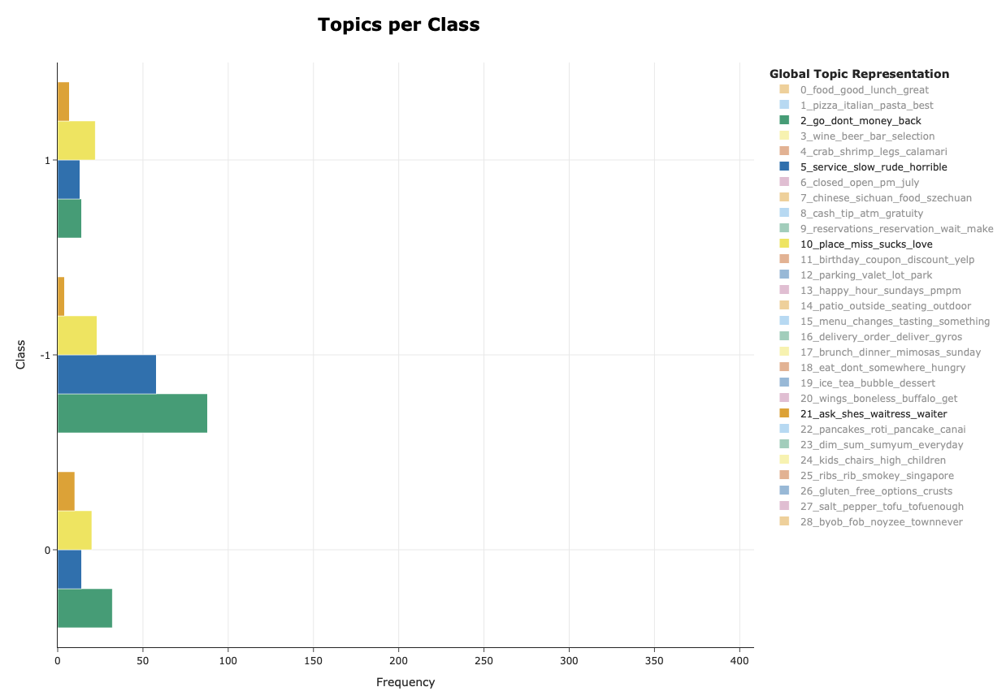
Insights/Results
Sentiment Classification Topic Modeling
Negative sentiment:
Topics:
service_slow_rude_horrible
go_don’t_money_back
place_miss_sucks_love
ask_shes_waitress_waiter
Poor service and refund problems
Operating hours
Negative overall experience
Waiting Staff issues

Slide 18
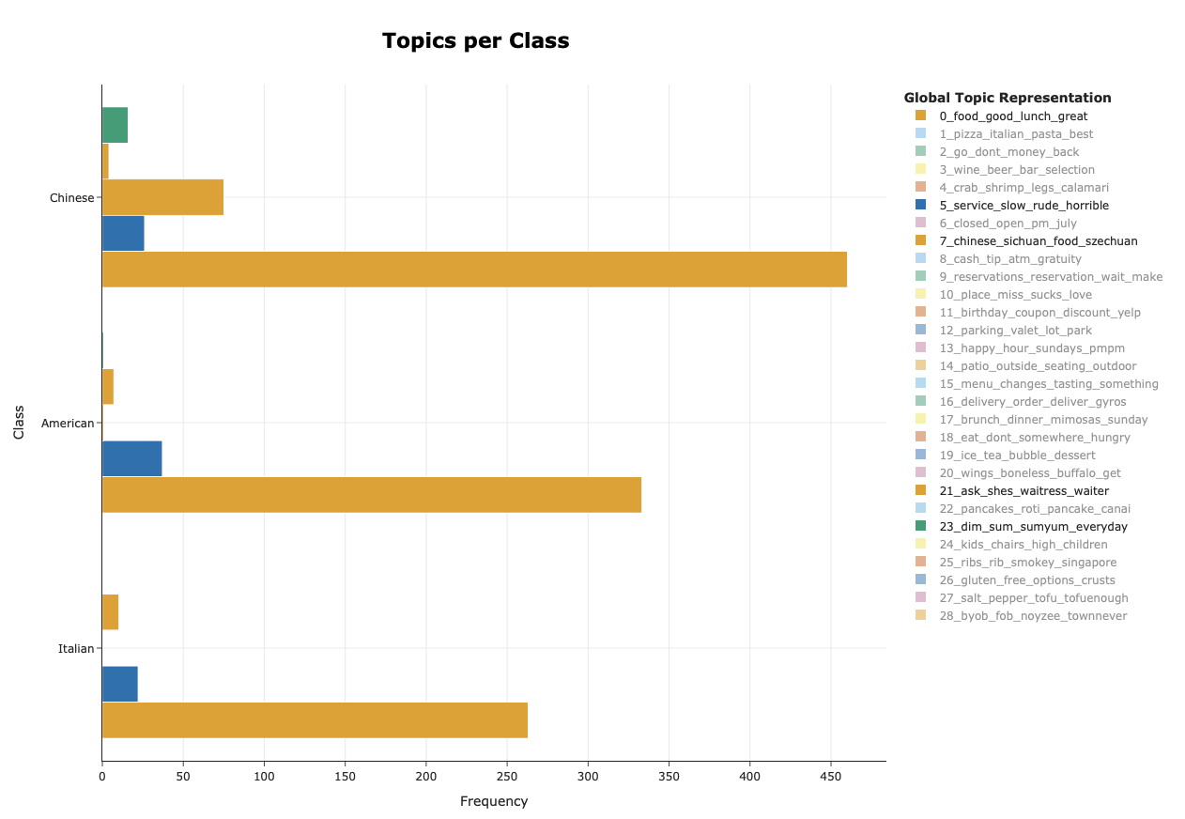
Insights/Results
Cuisine Classification Topic Modeling
All cuisines:
Topics:
food_good_lunch_great
service_slow_rude_horrible
Food quality across all types of restaurants
Service issues among all cuisines
Chinese Cuisine:
Topics:
chinese_sichuan_food_szechuan
dim_sum_sumyum_everyday
ask_shes_waitress_watier
Main dishes are important
Service complaints

Slide 19
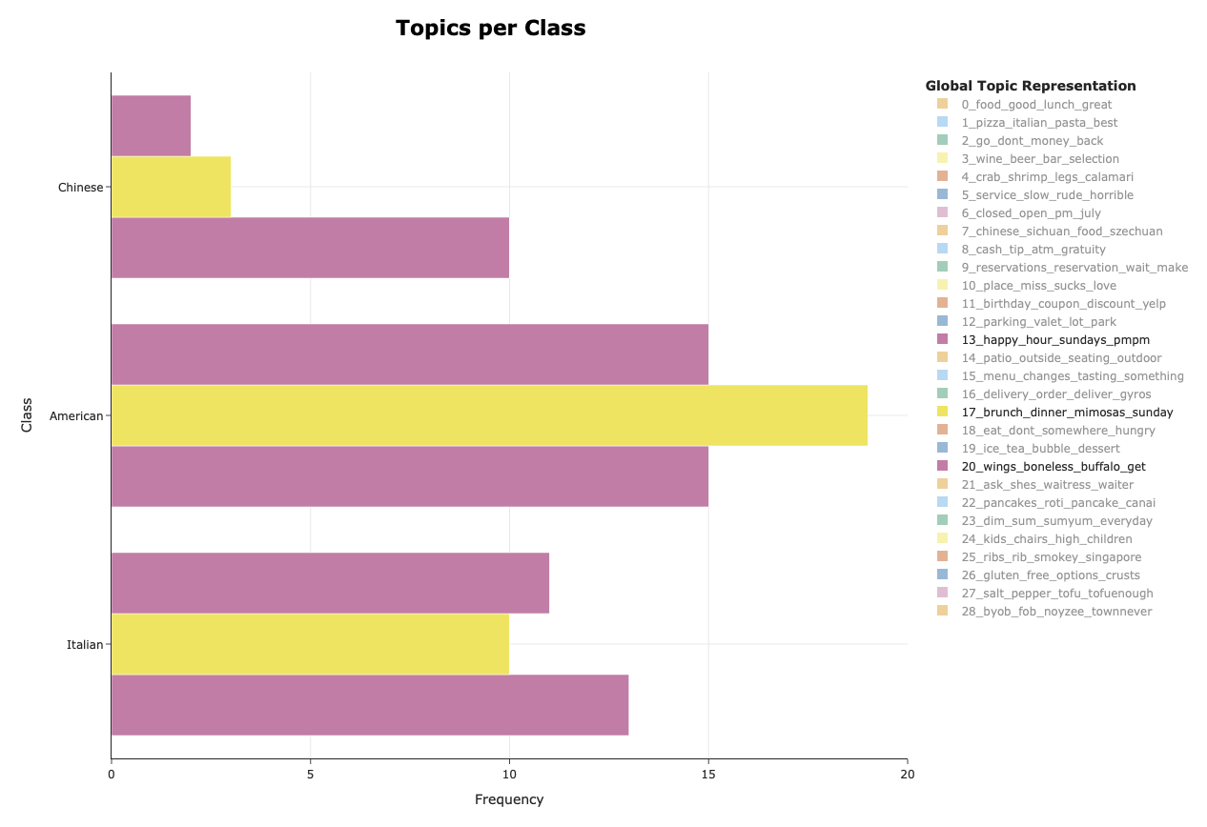
Insights/Results
Cuisine Classification Topic Modeling
American Cuisine:
Topics:
wings_boneless_buffalo_get
brunch_dinner_mimosas_sunday
happy_hour_sunday_ppmp
Main dishes are important
Brunch is popular meal
Happy hour is apart of American culture

Slide 20
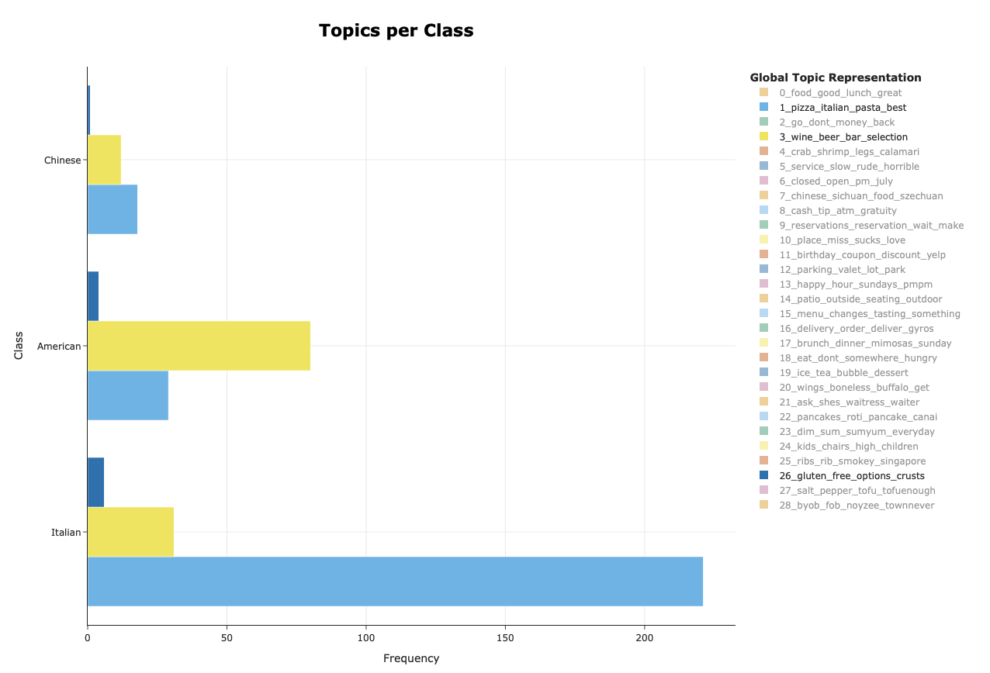
Insights/Results
Cuisine Classification Topic Modeling
Italian Cuisine:
Topics:
pizza_italian_pasta_best
wine_beer_bar_selection
gluten_free_options_crusts
Pasta most important dish of cuisine
Dining paired with wine and beer
Gluten free options (pizza and pasta)

Slide 21
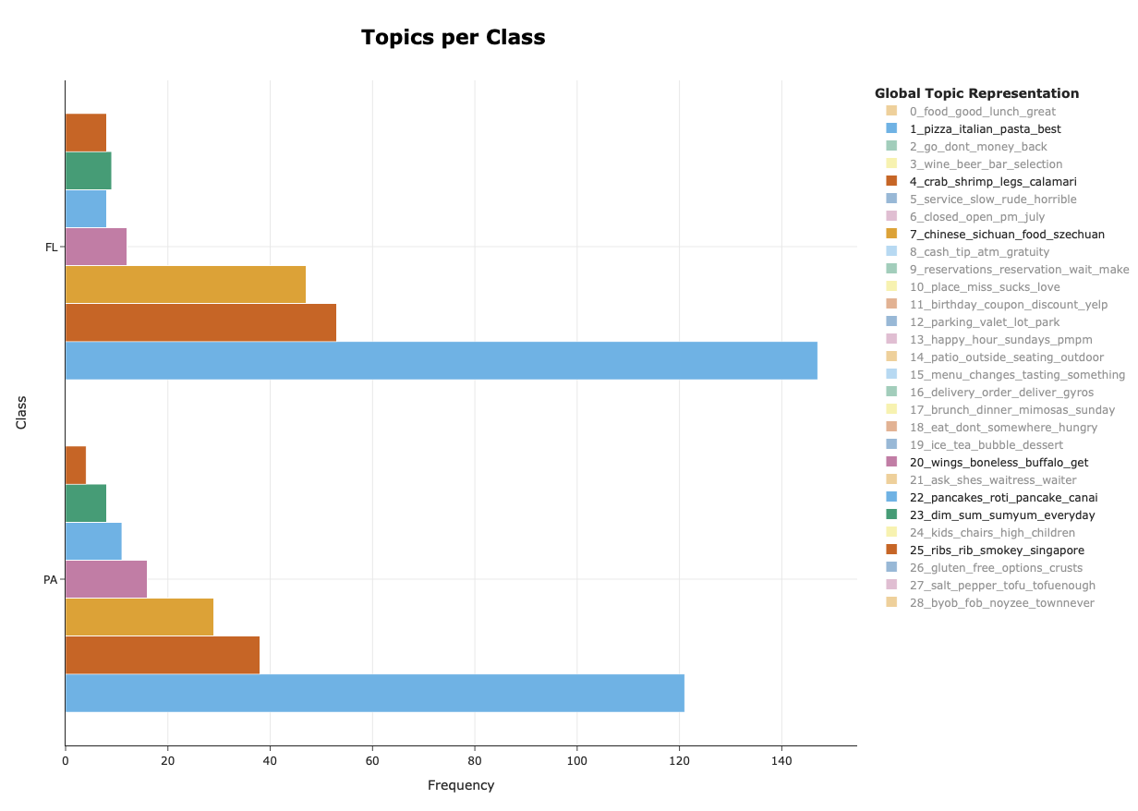
Insights/Results
State Food Preferences Classification Topic Modeling
Florida:
Food preferences
Italian (Higher)
Seafood (Higher)
Chinese (Sichuan)
Wings
Pancakes
Barbecue (Higher)
Pennsylvania:
Food preferences
Italian
Seafood
Chinese (Dim sum)
Wings (Higher)
Pancakes (Higher)
Barbecue
Mainly same order, but frequency differs showing preference in taste and specific dishes

Slide 22
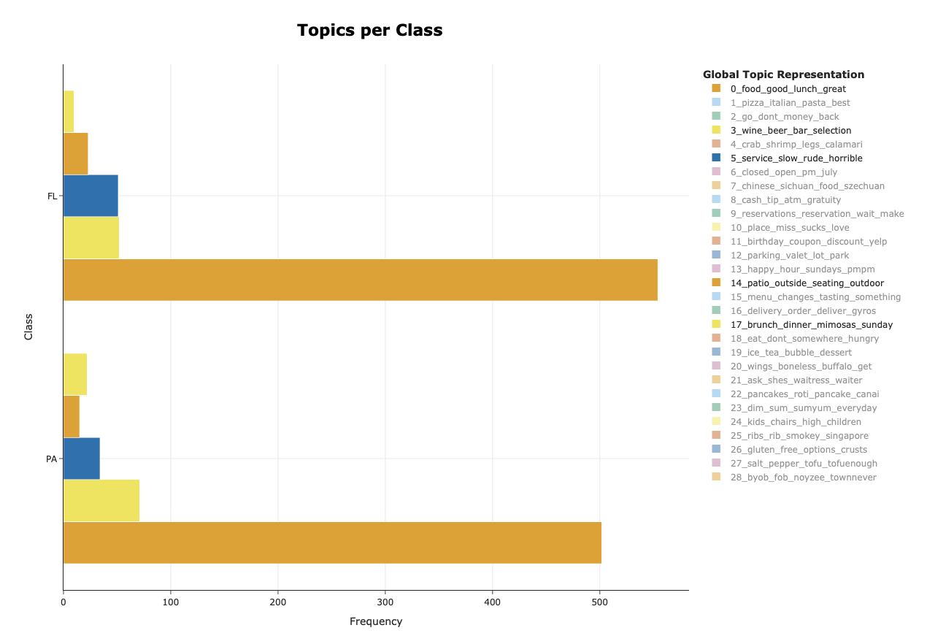
Insights/Results
State FL Classification Topic Modeling
Both states:
Topics:
food_good_lunch_great
service_slow_rude_horrible
Food quality important in both states
Service issues
Florida:
Topics:
patio_outside_seating_outdoor
brunch_dinner_mimosas_sunday
wine_beer_bar_selection
Outdoor dining and alcohol
Brunch is main meal

Slide 23
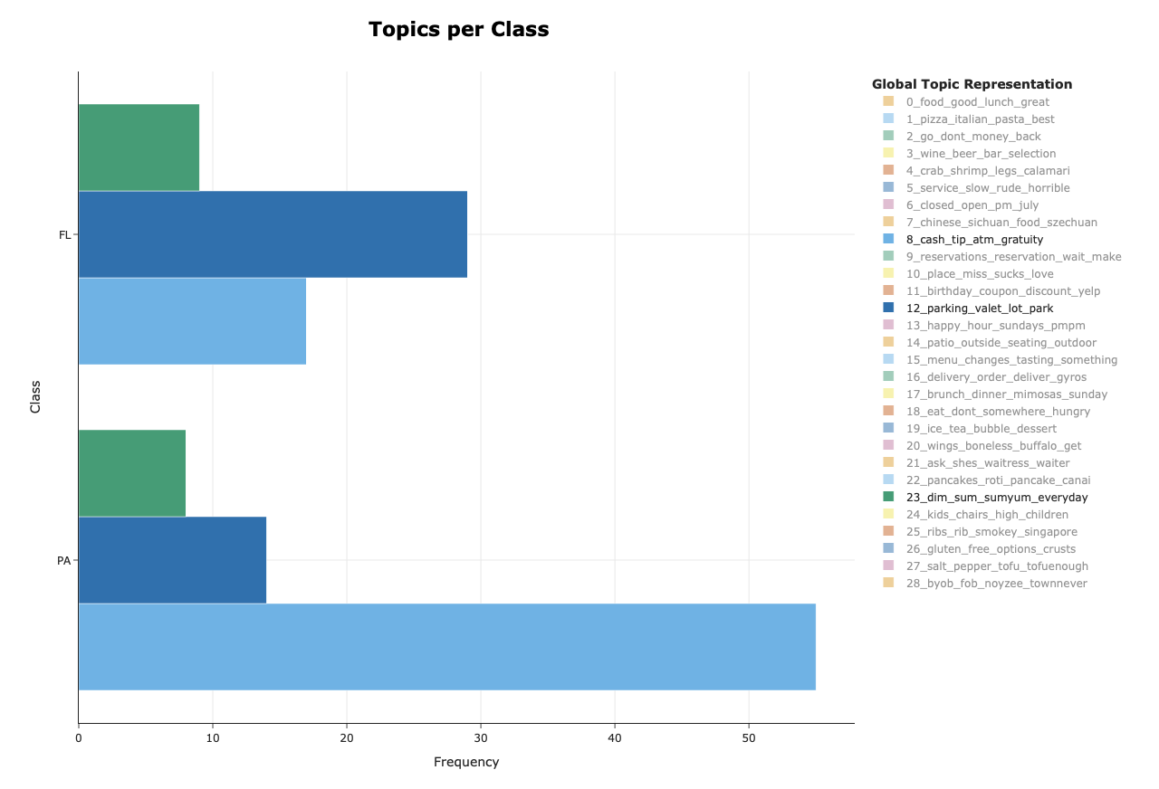
Insights/Results
State (PA) Classification Topic Modeling
Pennsylvania:
Topics:
parking_valet_lot_park
cash_tip_atm_gratuity
dim_sum_sumyum_everyday
Parking issues
Service (tips)

Slide 24
Conclusion/Recommendations
Sentiment Classification
Cuisine Classification
State Classification
Cuisine emphasize food quality and specific dishes
Customers interact differently depending on cuisines
American:
Emphasize brunch specials and happy hour
Italian:
Expand gluten-free options
Chinese:
Improve quality of service
Cuisine preference differ by state. Restaurant critique business strategies to meet customer preferences in different locations
Florida:
Improve outdoor seating options
Offer more brunch specials
Pennsylvania:
Parking situation (urban restaurants)
Service quality
Food quality is main driver for overall satisfaction
Service-related issues correlate highly with negative reviews
Neutral review are operational issues and logistics

Slide 25

THANK YOU!

